Slide 1
Advanced Computer Architecture (ACA 2018)
Prof. SHEN Li
College of Computer, NUDT
Fall, 2018

Slide 2
Lecture 03 Pipeline
October 24, 2018

Slide 3
Objects Today
The Basic 5-Stage Pipeline
Pipeline Hazard
Methods to Avoid Hazard
The Implementation of Pipelines
Exceptions and Interrupts

Slide 4
5 Steps of MIPS Datapath
Instruction
Fetch
Instr. Decode
Reg. Fetch
Execute
Addr. Calc
Memory
Access
Write
Back
Next PC
MUX
Next SEQ PC
Adder
4
RS1
Zero?
Address
RS2
Reg File
Memory
MUX
Inst
Data
Memory
RD
MUX
ALU
L
M
D
MUX
Imm
Sign
Extend
IR <= mem[PC];
PC <= PC + 4
WB Data
Reg[IR_{rd}] <= Reg[IR_{rs}] op_{IRop} Reg[IR_{rt}]

Slide 5
Inst. Set Processor Controller
IR <= mem[PC];
PC <= PC + 4
IR <= mem[PC];
PC <= PC + 4
Ifetch
Ifetch
JR
JAL
A <= Reg[IR_{rs}];
B <= Reg[IR_{rt}]
A <= Reg[IR_{rs}];
B <= Reg[IR_{rt}]
opFetch-DCD
opFetch-DCD
ST
J
br
J
br
RR
RI
LD
PC <= IR_{jaddr}
r <= A op_{IRop} IR_{im}
r <= A + IR_{im}
if bop(A,b)
PC <= PC+IR_{im}
PC <= IR_{jaddr}
if bop(A,b)
PC <= PC+IR_{im}
r <= A op_{IRop} B
WB <= r
WB <= r
WB <= Mem[r]
Reg[IR_{rd}] <= WB
Reg[IR_{rd}] <= WB
Reg[IR_{rd}] <= WB

Slide 6
Pipelined MIPS
The appropriate registers between each pipeline stage are called
Pipeline registers or pipeline latches
The registers are labeled with the names of the stages they connect
IF/ID -- ID/EX -- EX/MEM -- MEM/WB

Slide 7
Pipelined Datapath: Original
0x4
Add
rs1
we
rs2
rd1
we
addr
rdata
ws
addr
wd
rd2
ALU
GPRs
rdata
Inst.
Memory
Data
Memory
Imm
Ext
wdata

Slide 8
Pipelined Datapath: With latches and Stages
0x4
Add
rs1
we
rs2
rd1
we
PC
addr
rdata
IR
ws
addr
wd
rd2
ALU
GPRs
rdata
Inst.
Memory
Data
Memory
Imm
Ext
wdata
write
-back
phase
fetch
phase
decode & Reg-fetch
phase
execute
phase
memory
phase

Slide 9
Pipelined Datapath: Clock Cycle Time
0x4
Add
rs1
we
rs2
rd1
we
PC
addr
rdata
IR
ws
addr
wd
rd2
ALU
GPRs
rdata
Inst.
Memory
Data
Memory
Imm
Ext
wdata
write
-back
phase
fetch
phase
decode & Reg-fetch
phase
execute
phase
memory
phase
Clock cycle time can be reduced by dividing the execution of an instruction into multiple cycles
t_{C} > max {t_{IM}, t_{RF}, t_{ALU}, t_{DM}, t_{RW}} (= t_{DM} probably)

Slide 10
Visualizing and Ideal Pipelining
Time (clock cycles)
Cycle 1
Cycle 2
Cycle 3
Cycle 4
Cycle 5
Cycle 6
Cycle 7
I
n
s
t
r.
O
r
d
e
r
Ifetch
Reg
ALU
DMem
Reg
Ifetch
Reg
ALU
DMem
Reg
Ifetch
Reg
ALU
DMem
Reg
Ifetch
Reg
ALU
DMem
Reg

Slide 11
Next …
Appendix C2:
Pipelining Hurdle - Hazards

Slide 12
Limitation to pipelining: Hazards
HAZARDS prevent next instruction from executing during its designated clock cycle
Three classes of hazards
STRUCTURAL hazards: HW cannot support this combination of instructions
DATA hazards: Instruction depends on result of prior instruction still in the pipeline
CONTROL hazards: Caused by delay between the fetching of instructions and decisions about changes in control flow

Slide 13
Structure Hazards: One Port Memory
Time (clock cycles)
Cycle 1
Cycle 2
Cycle 3
Cycle 4
Cycle 5
Cycle 6
Cycle 7
I
n
s
t
r.
O
r
d
e
r
Load
Ifetch
Reg
ALU
DMem
Reg
Instr 1
Ifetch
Reg
ALU
DMem
Reg
Instr 2
Ifetch
Reg
ALU
DMem
Reg
Instr 3
Ifetch
Reg
ALU
DMem
Reg
Instr 4
Ifetch
Reg
ALU
DMem
Reg

Slide 14
Structure Hazards: Stall
Time (clock cycles)
Cycle 1
Cycle 2
Cycle 3
Cycle 4
Cycle 5
Cycle 6
Cycle 7
I
n
s
t
r.
O
r
d
e
r
Load
Ifetch
Reg
ALU
DMem
Reg
Instr 1
Ifetch
Reg
ALU
DMem
Reg
Instr 2
Ifetch
Reg
ALU
DMem
Reg
Stall
Bubble
Bubble
Bubble
Bubble
Bubble
Instr 3
Ifetch
Reg
ALU
DMem
Reg

Slide 15
Data Hazards on R1
Time (clock cycles)
IF
ID/RF
EX
MEM
WB
I
n
s
t
r.
O
r
d
e
r
add r1,r2,r3
Ifetch
Reg
ALU
DMem
Reg
Ifetch
Reg
ALU
DMem
Reg
sub r4,r1,r3
Ifetch
Reg
ALU
DMem
Reg
and r6,r1,r7
Ifetch
Reg
ALU
DMem
Reg
or r8,r1,r9
xor r10,r1,r11
Ifetch
Reg
ALU
DMem
Reg

Slide 16
Types of Data Hazards
When an instruction depends on the RESULTS of a previous instruction in a way that is exposed by the overlapping of instructions in the pipeline
Read after write
Write after read
Write after write
Read after read (?)

Slide 17
Data Hazards of “r1”
Read After Write (RAW)
I: add r1,r2,r3
J: sub r4,r1,r3
Write After Read (WAR)
I: sub r4,r1,r3
J: add r1,r2,r3
Write After Write (WAW)
I: sub r1,r4,r3
J: add r1,r2,r3

Slide 18
Forwarding to avoid Data Hazard
Time (clock cycles)
I
n
s
t
r.
O
r
d
e
r
add r1,r2,r3
Ifetch
Reg
ALU
DMem
Reg
sub r4,r1,r3
Ifetch
Reg
ALU
DMem
Reg
and r6,r1,r7
Ifetch
Reg
ALU
DMem
Reg
or r8,r1,r9
Ifetch
Reg
ALU
DMem
Reg
xor r10,r1,r11
Ifetch
Reg
ALU
DMem
Reg

Slide 19
Hardware Changes for Forwarding
NextPC
ID/EX
EX/MEM
MEM/WR
Registers
mux
ALU
Data
Memory
mux
mux
Immediate

Slide 20
Data Hazard Even with Forwarding
Time (clock cycles)
I
n
s
t
r.
O
r
d
e
r
lw r1, 0(r2)
Ifetch
Reg
ALU
DMem
Reg
sub r4,r1,r6
Ifetch
Reg
ALU
DMem
Reg
and r6,r1,r7
Ifetch
Reg
ALU
DMem
Reg
or r8,r1,r9
Ifetch
Reg
ALU
DMem
Reg

Slide 21
Data Hazard Even with Forwarding
Time (clock cycles)
I
n
s
t
r.
O
r
d
e
r
lw r1, 0(r2)
Ifetch
Reg
ALU
DMem
Reg
sub r4,r1,r6
Ifetch
Reg
Bubble
ALU
DMem
Reg
Ifetch
Bubble
Reg
ALU
DMem
Reg
and r6,r1,r7
Bubble
Ifetch
Reg
ALU
DMem
or r8,r1,r9

Slide 22
Control Hazard on Branches
10: beq r1,r3,36
14: and r2,r3,r5
18: or r6,r1,r7
22: add r8,r1,r9
36: xor r10,r1,r11
Ifetch
Reg
ALU
DMem
Reg
Ifetch
Reg
ALU
DMem
Reg
Ifetch
Reg
ALU
DMem
Reg
Ifetch
Reg
ALU
DMem
Reg
Ifetch
Reg
ALU
DMem
Reg

Slide 23
The Revised Pipeline
Instruction
Fetch
Instr. Decode
Reg. Fetch
Execute
Addr. Calc
Memory
Access
Write
Back
Next PC
Next SEQ PC
ID/EX
EX/MEM
MEM/WB
MUX
IF/ID
Adder
Adder
Zero?
4
RS1
Address
Memory
RS2
Reg File
ALU
Data
Memory
MUX
MUX
Sign
Extend
Imm
WB Data
RD
RD
RD

Slide 24
Control Hazard on Branches
10: beq r1,r3,36
14: and r2,r3,r5
18: or r6,r1,r7
22: add r8,r1,r9
36: xor r10,r1,r11
Ifetch
Reg
ALU
DMem
Reg
Ifetch
Reg
ALU
DMem
Reg
Ifetch
Reg
ALU
DMem
Reg
Ifetch
Reg
ALU
DMem
Reg
Ifetch
Reg
ALU
DMem
Reg

Slide 25
Four Branch Hazard Alternatives
#1: Stall until branch direction is clear
#2: Predict Branch Not Taken
#3: Predict Branch Taken
#4: Delayed Branch

Slide 26
Next…
Appendix C2: Branch Penalties Reducing

Slide 27
Dealing the branch delay in compiler
The actions for a branch are static
Static — they are fixed for each branch during the entire execution
The software can try to minimize the branch penalty using knowledge
of the hardware scheme
of branch behavior
Chapters 3 looks at more powerful hardware and software techniques for both static and dynamic branch prediction

Slide 28
Four Simple Compilation Strategies
Freeze
Flush the pipeline
Predicted-not-taken
Predicted-untaken scheme
Treat every branch as taken
Delayed branch
This technique was heavily used in early RISC processors and works reasonably well in the five-stage pipeline

Slide 29
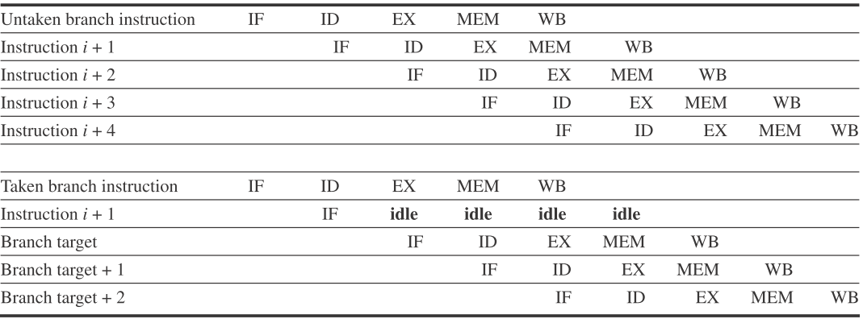
Untaken and Taken in a Predicted-not-taken
Untaken
Taken
Branch target
When the branch is untaken, determined during ID, we have fetched the fall-through and just continue
If the branch is taken during ID, we restart the fetch at the branch target
This causes all instructions following the branch to stall 1 cycle

Slide 30
Delayed Branch
In a delayed branch, the execution cycle with a branch delay of one is
branch instruction
sequential successor1
branch target if taken
The sequential successor is in the branch delay slot
This instruction is executed whether or not the branch is taken

Slide 31
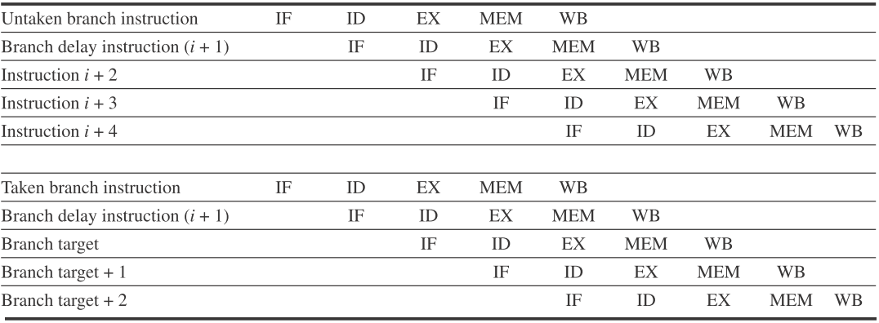
The Behavior of A Delayed Branch
Branch delay instruction ( i+1 )
untaken
Branch delay instruction ( i+1 )
taken
The instructions in the delay slot are executed
If the branch is untaken, execution continues with the instruction after the branch delay instruction
If the branch is taken, execution continues at the branch target

Slide 32
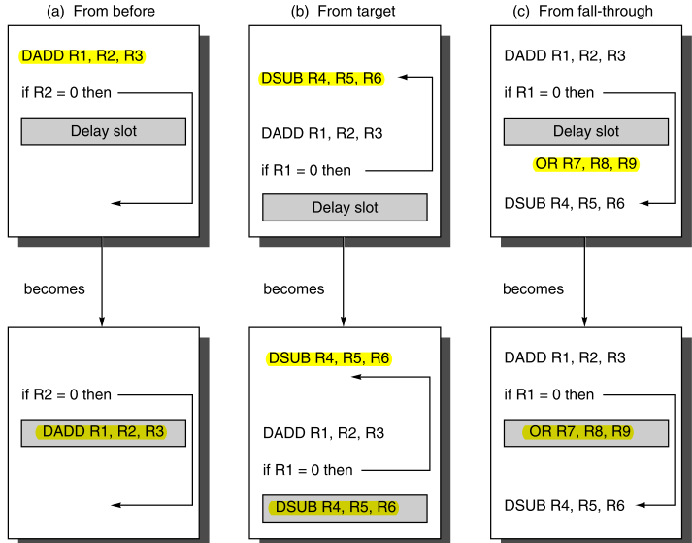
Scheduling the Branch Delay Slot
the best choice
reached by another path
R7 were an unused register

Slide 33
Delayed Branch Slot(s) Processing
Almost all processors with delayed branch have a single instruction delay
It is possible to have a branch delay longer than one
When the instruction in the branch delay slot is also a branch, the meaning is unclear
If the branch is not taken, what should happen to the branch in the branch delay slot?
Because of this confusion, architectures with delay branches often disallow putting a branch in the delay slot

Slide 34
Next …
Static Branch Prediction

Slide 35
The Simplest Scheme: Predict as Taken
An average misprediction rate that is equal to the untaken branch frequency
For the SPEC programs is 34%
Unfortunately, the misprediction rate for the SPEC ranges from not very accurate (59%) to highly accurate (9%)

Slide 36
Direction-based Prediction
A Better Alternative
Predict on the basis of branch direction
Backward-going branches to be TAKEN
Forward-going branches to be NOT TAKEN
In the SPEC, More than half of the forward-going branches are taken
-> predicting branches as taken is better
For other benchmarks or compilers, misprediction rate is 30% to 40%

Slide 37
An Enhanced Direction-based Prediction
Uses program context information
Using previous branch information
Generates more accurate predictions than a simple scheme based solely on branch direction

Slide 38
Profile-based Prediction
A More Accurate Technique
Predict branches on the basis of profile information collected from earlier runs
An individual branch is often highly biased toward taken or untaken
Changing the input leads to only a small change in the prediction accuracy

Slide 39
Profile-based Prediction: Misprediction
Varies widely
The FP, an average rate of 9% with a standard deviation of 4%
The integer, an average rate of 15% with a standard deviation of 5%

Slide 40
Instructions between Misprediction
Varies widely
The FP, an average rate of 9% with a standard deviation of 4%
The integer, an average rate of 15% with a standard deviation of 5%

Slide 41
Usage of Static Branch Prediction
Static
Sometimes be used in processors where the expectation is that branch behavior is highly predictable at compile-time
Also be used to assist dynamic predictors
Compiler

Slide 42
Next …
The Simplest Dynamic Branch Prediction – Branch-Prediction Buffer (BPB)

Slide 43
A General Dynamic Branch Prediction Scheme
Incoming stream of addresses
Fast outgoing stream of predictions
Correction information returned from pipeline
Branch
Predictor
Incoming Branches
{ Address }
Prediction
{ Address, Value }
History
Information
Corrections
{ Address, Value }

Slide 44
BPB Principles
The simplest dynamic branch prediction
Check the branch taken/untaken last time
A BPB is a small memory
1 bit says whether branch taken last time
Indexed by the lower bits of the branch instruction address
If the prediction turns out to be wrong, the bit is inverted
It is also called Branch History Buffer (BHB)
 | Predictor 0
 | Predictor 1
lower
bits
of the
branch
PC
 | Predictor 2^{n}-1

Slide 45
1-bit BPB Scheme
Prediction accuracy is about 80%
Almost all loop will predict incorrectly twice

Slide 46
2-bit BPB Scheme
A prediction must miss twice in a row before the prediction is changed
Studies using SPEC89 have shown
A hit rate 82~99% for a 4K entries buffer
The highest accuracy comes in which have lots of loops
Straight-line code has the worst accuracy

Slide 47
States in a 2-bit Scheme
Taken
Not taken
Predict taken
11
Predict taken
10
Taken
Taken
Not taken
Not taken
Predict not taken
01
Predict not taken
00
Taken
Not taken

Slide 48
BPB Examples
Consider a loop
Branch behavior is taken 9 times in a row
Then not taken once
What is the prediction accuracy for this branch?
Original states: not taken(0)

Slide 49
BPB Examples - Answer
Mispredict twice: the first and last loop iterations.
The first iteration: the loop taken
The last iteration: the loop not taken
loop 1 (0-1/1) > loop 2 (1-1/1) …… > loop 9 (1-1/1) > loop 10 (1-0/0)
Two important concepts
The prediction accuracy: 80%
The branch taken rate: 90%

Slide 50
BPB Examples - Accuracy
Prediction accuracy of a 4K-entry 2-bits BPB for SPEC89 (IBM Power)
Accuracy: 82% ~ 99%
Integer benchmarks: average mis 11%
gcc, espresso, eqntott, li
FP benchmark: average mis 4%
nasa7, matrix300, tomcatv
Why they are deference?

Slide 51
Mispredictions

Slide 52
States in a 2-bit Scheme: an Alternation
Taken
Not taken
Predict taken
11
Predict taken
10
Taken
Taken
Not taken
Not taken
Predict not taken
01
Predict not taken
00
Taken
Not taken

Slide 53
n-bit branch predictor
The predictor counter can take on values between 0~(2^{n}–1)
Counter≥2^{n–2}, predicted as taken
Otherwise, predicted untaken
Studies shown: the n-bit predictors and the 2-bit predictors do almost as well
Most systems rely on 2-bit branch predictors rather than n-bit predictors
Question
How many entries of a BPB is batter?

Slide 54
Entries’ Mis : 4K vs. Unlimited, 2bit/entry

Slide 55
BPB: Typical Implementation
As a small, special-purpose “cache”
which is accessed with the instruction address during the IF pipe stage
As bits that are attached to instruction cache and fetched with each instruction
If the instruction is decoded as a branch -> the bits fetched predict it as
Taken -> fetching begins from the target as soon as the PC is known
Not taken -> sequential fetching continues

Slide 56
BPB: illustrations
Lower bits of branch address | … |  |  | Lower bits of branch address | … | …
1-bit scheme |  |  | 2-bit scheme

Slide 57
BPB: Instruction Fetch
Fetch PC
0
0

Slide 58
BPB: Accessing I-Cache and BPB
Fetch PC
0
0
I-Cache
k
2^{k}-entry
BPB,
2 bits/entry
BPB Index
Instruction
Opcode
offset
Taken/¬Taken?

Slide 59
BPB: Instruction Decoding and Correctness Checking
Fetch PC
0
0
I-Cache
k
2^{k}-entry
BPB,
2 bits/entry
BPB Index
Instruction
Opcode
offset
+
Branch?
Target PC
Taken/¬Taken?
2^{K}-entry BPB, 2 bits/entry, ~80-90% correct predictions

Slide 60
Next ...
Appendix C4
What makes Piplining Hard to Implement ?

Slide 61
Exception and Interrupt
Exception
An unusual event happens to an instruction during its execution
Examples: divide by zero, undefined opcode
Interrupt
Hardware signal to switch the processor to a new instruction stream
Example: a key pressed

Slide 62
Exception and Interrupt Types
I/O device request
Invoking an operating system service from a user program
Tracing instruction execution or breakpoint (programmer-requested interrupt)
Page fault (not in main memory)
Memory-protection violation

Slide 63
Problems
It must appear that the exception or interrupt must appear between 2 instructions (I_{i} and I_{i+1})
The effect of all instructions up to and including I_{i} is totally complete
No effect of any instruction after I_{i} can take place
The interrupt (exception) handler either aborts program or restarts at instruction I_{i+1}

Slide 64
Safety Steps
Force a trap instruction into the pipeline on the next IF
Until the trap is taken, turn off all writes for the faulting instruction
The following exception-handling routine immediately saves the PC of the faulting instruction

Slide 65
Precise Exceptions
If the pipeline can be stopped just before the faulting instruction are completed and those after it can be restarted from scratch
Any processor with demand paging or IEEE arithmetic trap handlers must make its exceptions precise

Slide 66
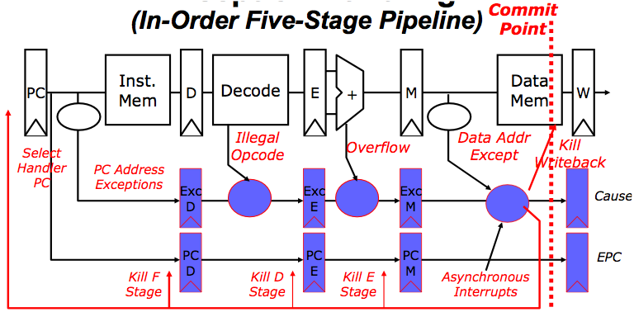
Precise Exceptions in Static Pipelines
Key observation: architected state only change in memory and register write stages

Slide 67
Next ...
Appendix C5
Multicycle Operations

Slide 68
Handle Multicycle Operations
The floating-point pipeline will allow for a longer latency for operations
The EX cycle may be repeated as many times as needed to complete the operation
The number of repetitions can vary for different operations
There may be multiple FP functional units
A structural hazard for the FU it uses
Or cause a data hazard

Slide 69
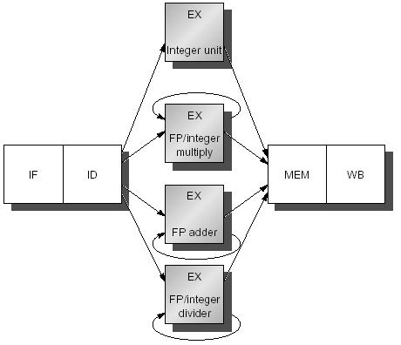
Four Separate FUs In Our MIPS

Slide 70
Latency and Initiation Interval
Functional unit | Latency | Initiation interval
Integer ALU | 0 | 1
Data memory (int & FP loads) | 1 | 1
FP add | 3 | 1
FP multiply (also int. multiply) | 6 | 1
FP divide (also integer divide) | 24 | 25

Slide 71
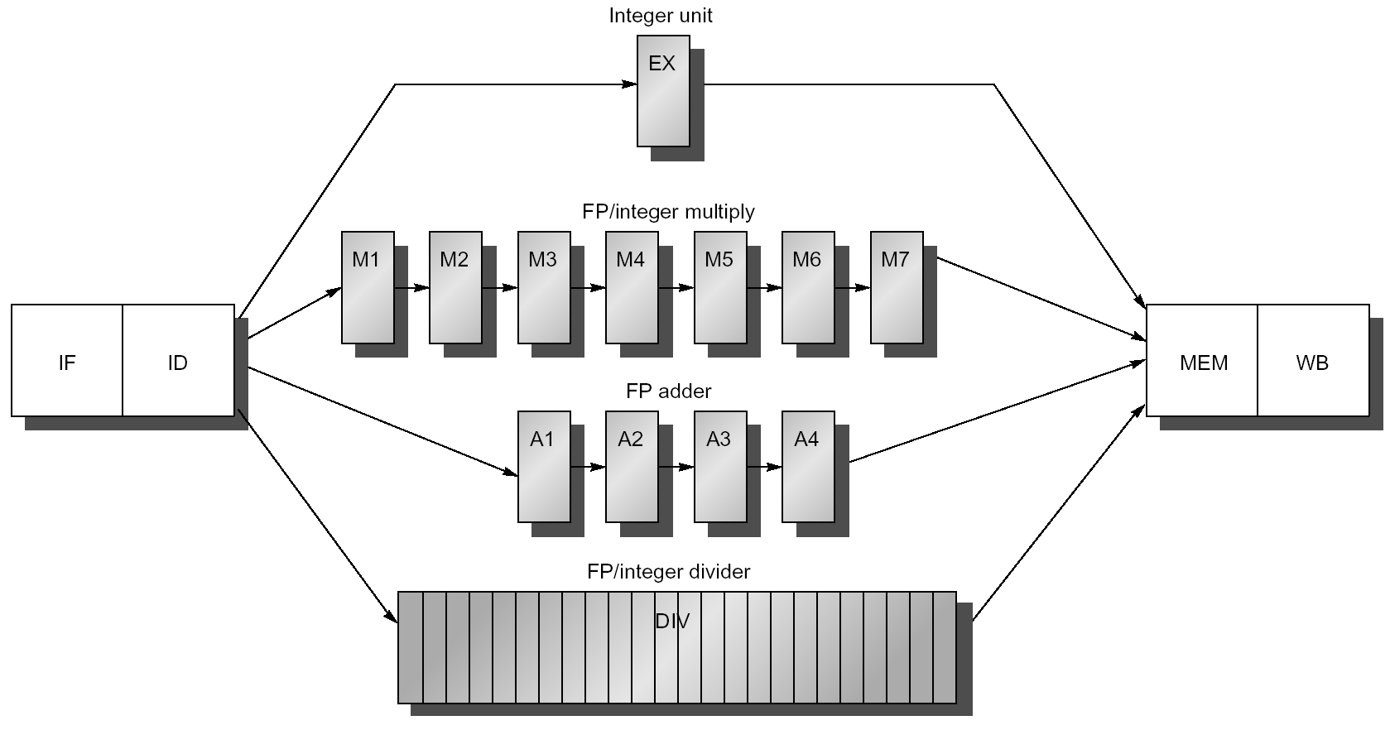
The Pipelines

Slide 72
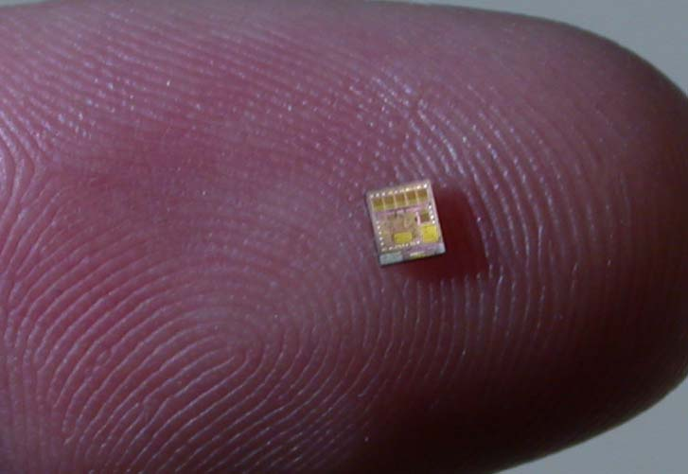
How Big a Chip

Slide 73
How Big a Chip

Slide 74
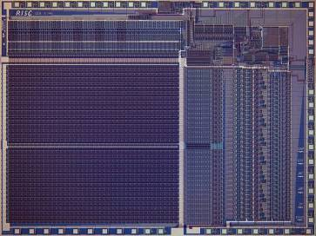
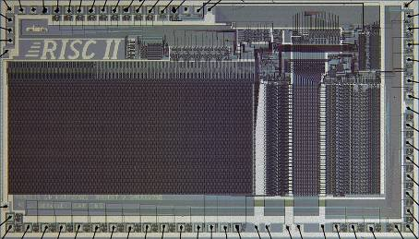
Berkeley RISC Chips
RISC-I (1982)
Contains 44,420 transistors
Fabbed in 5 µm NMOS, ran at 1 MHz with a die area of 77 mm²
This chip is probably the first VLSI
RISC RISC-II (1983)
Contains 40,760 transistors
Fabbed in 3 µm NMOS, ran at 3 MHz, and the die size is 60 mm²
74

Slide 75
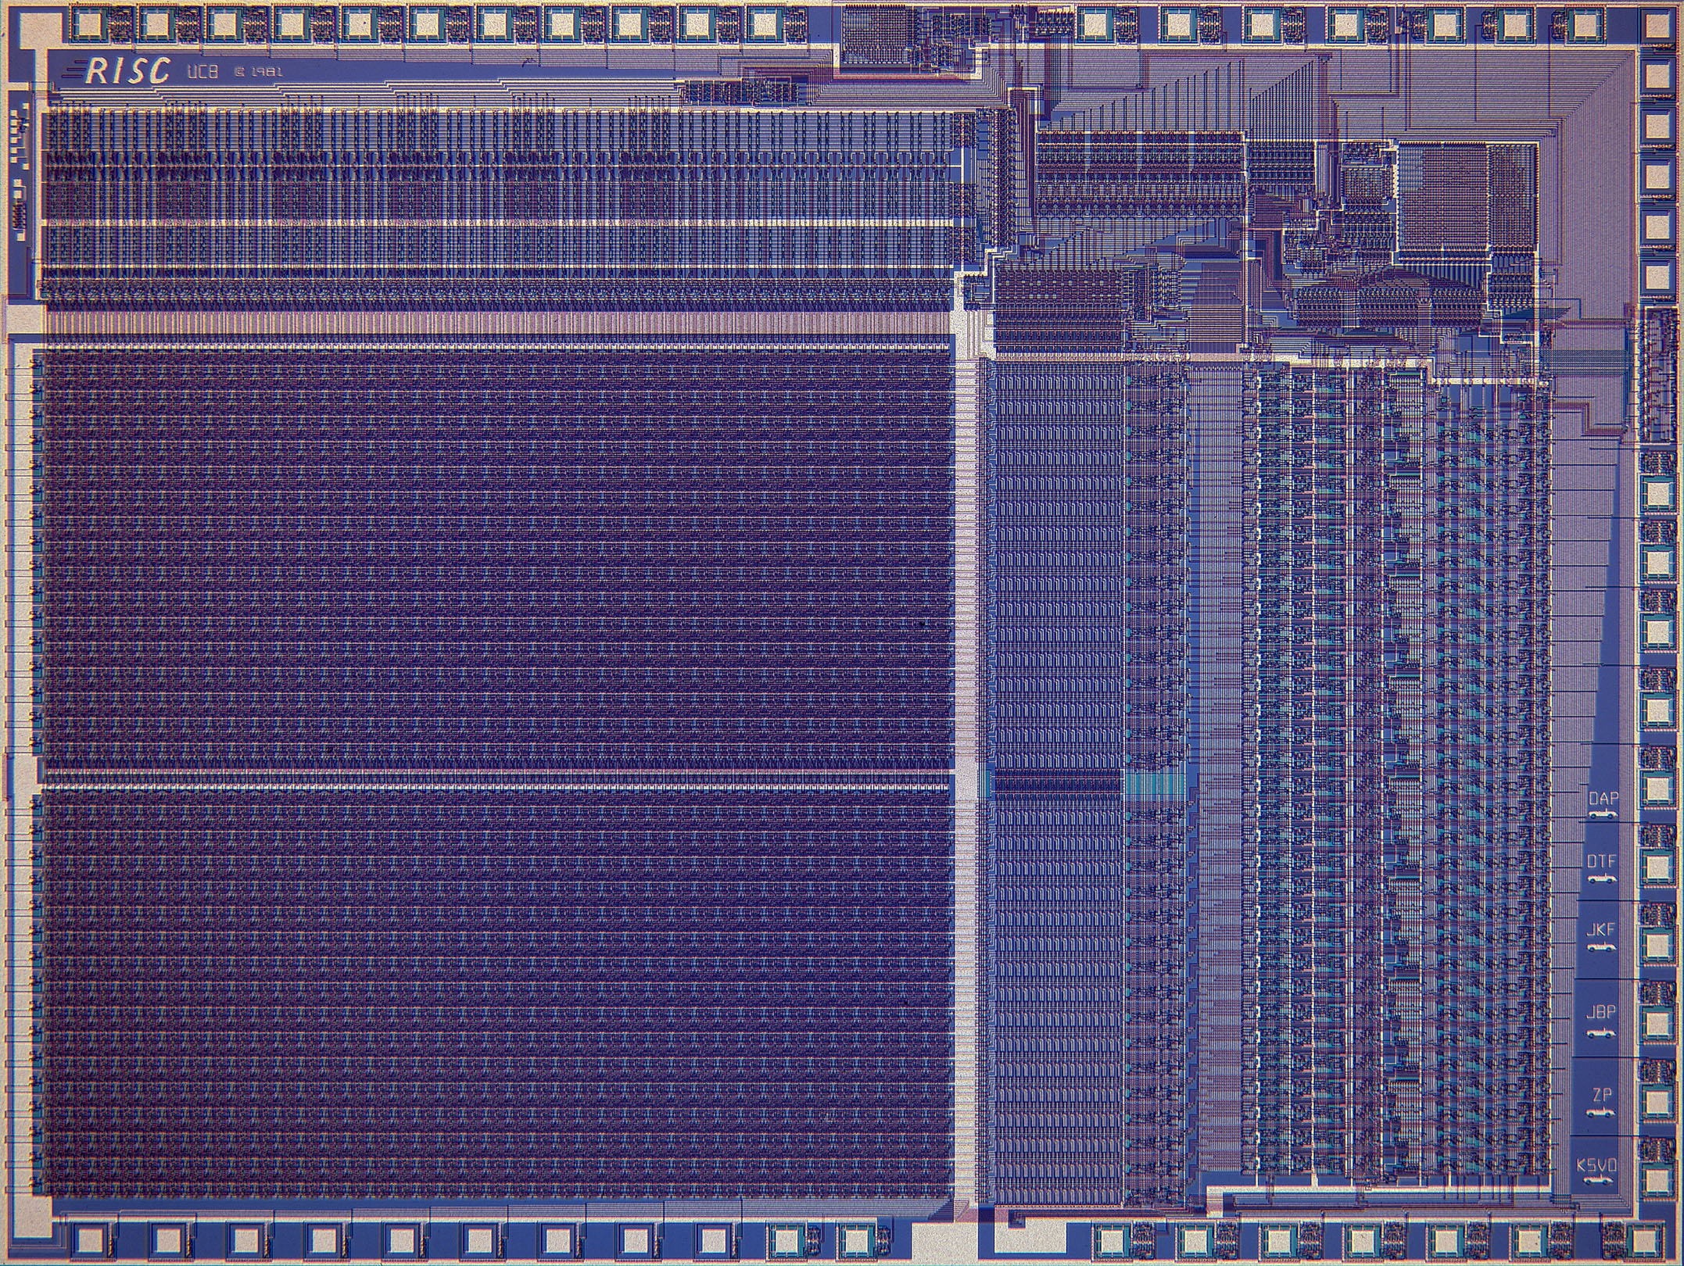

Slide 76
Big PIC of RISC II
RISC-I (1982)
Contains 44,420 transistors
Fabbed in 5 µm NMOS, ran at 1 MHz with a die area of 77 mm²
This chip is probably the first VLSI
RISC RISC-II (1983)
Contains 40,760 transistors
Fabbed in 3 µm NMOS, ran at 3 MHz, and the die size is 60 mm²

Slide 77

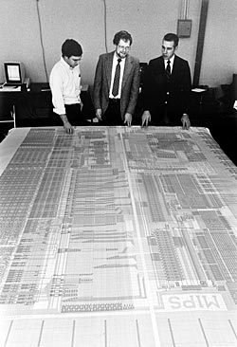
John L. Hennessy
Over the years, the duties of a university president have expanded dramatically. Stanford's president remains focused on and rooted in academics, but the job entails much more. Raising money, making decisions about future land use and addressing the needs of a medical center are just a few of the responsibilities of Stanford's tenth president, John L. Hennessy.
Stanford MIPS processor

Slide 78
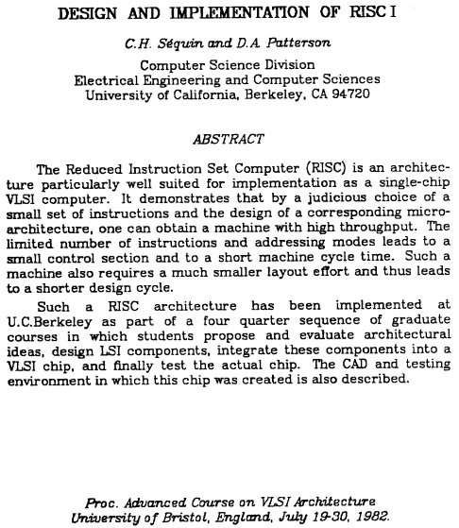
Reading Paper

Slide 79
Reading – 10min Presentations
Textbook
Appendix C
Papers
”Design and Implementation of RISC I", C.H. Sequin and D.A. Patterson, Proc. Advanced Course on VLSI architecture, 1982
Homeworks

Slide 80
Next…
Appendix C7: A Dynamic Scheduled
Pipeline – Scoringboard

